Slide 1
Designing for NFPs
Software Architecture
Lecture 19

Slide 2
What Is an NFP?
A software system’s non-functional property (NFP) is a constraint on the manner in which the system implements and delivers its functionality
Example NFPs
  Efficiency
  Complexity
  Scalability
  Heterogeneity
  Adaptability
  Dependability

Slide 3
Designing for FPs
Any engineering product is sold based on its functional properties (FPs)
  TV set, DVD player, stereo, mobile telephone
Providing the desired functionality is often quite challenging
  Market demands
  Competition
  Strict deadlines
  Limited budgets
However, the system’s success will ultimately rest on its NFPs
  “This system is too slow!”
  “It keeps crashing!”
  “It has so many security holes!”
  “Every time I change this feature I have to reboot!”
  “I can’t get it to work with my home theater!”

Slide 4
FPs vs. NFPs – An Example
Microsoft Word 6.0
  Released in the 1990s
  Both for the PC and the Mac
  Roughly the same functionality
  It ran fine on the PC and was successful
  It was extremely slow on the Mac
  Microsoft “solved” the problem by charging customers for downgrades
  A lot of bad publicity

Slide 5
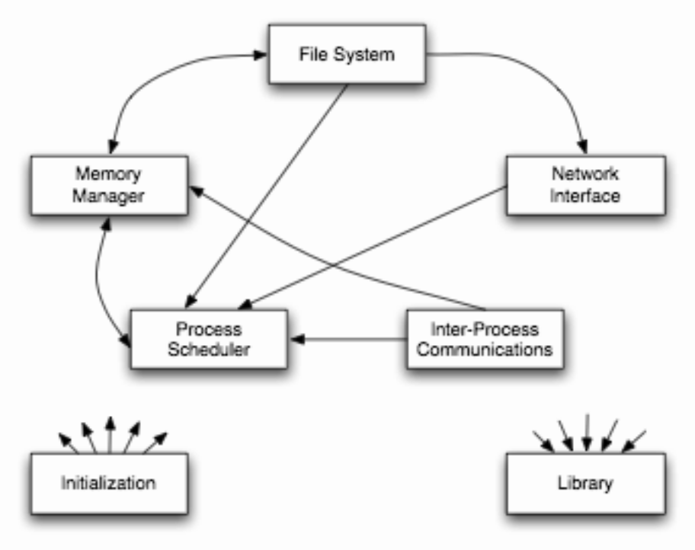
FPs vs. NFPs – Another Example
Linux – “as-documented” architecture
Software Architecture: Foundations, Theory, and Practice; Richard N. Taylor, Nenad Medvidovic, and Eric M. Dashofy; © 2008 John Wiley & Sons, Inc. Reprinted with permission.

Slide 6
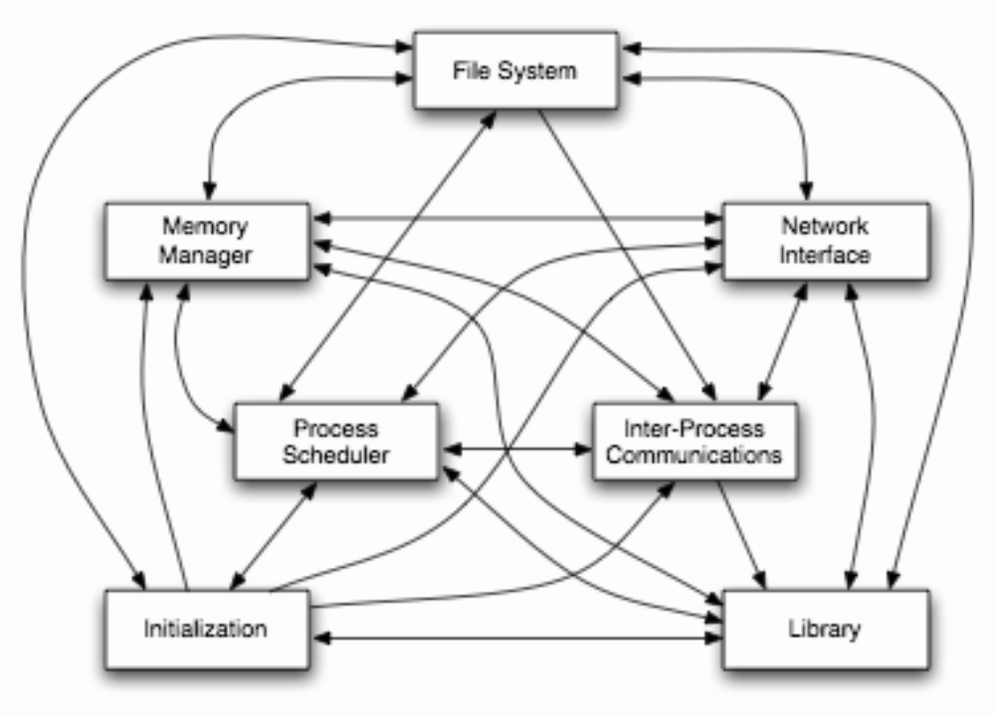
FPs vs. NFPs – Another Example
Linux – “as-implemented” architecture
Software Architecture: Foundations, Theory, and Practice; Richard N. Taylor, Nenad Medvidovic, and Eric M. Dashofy; © 2008 John Wiley & Sons, Inc. Reprinted with permission.

Slide 7
Challenges of Designing for NFPs
Only partially understood in many domains
  E.g., MS Windows and security
Qualitative vs. quantitative
Frequently multi-dimensional
Non-technical pressures
  E.g., time-to-market or functional features

Slide 8
Design Guidelines for Ensuring NFPs
Only guidelines, not laws or rules
Promise but do not guarantee a given NFP
Necessary but not sufficient for a given NFP
Have many caveats and exceptions
Many trade-offs are involved

Slide 9
Overarching Objective
Ascertain the role of software architecture in ensuring various NFPs
  At the level of major architectural building blocks
    Components
    Connectors
    Configurations
  As embodied in architectural style-level design guidelines

Slide 10
Efficiency
Efficiency is a quality that reflects a software system’s ability to meet its performance requirements while minimizing its usage of the resources in its computing environment
  Efficiency is a measure of a system’s resource usage economy
What can software architecture say about efficiency?
  Isn’t efficiency an implementation-level property?
Efficiency starts at the architectural level!

Slide 11
Software Components and Efficiency
Keep the components “small” whenever possible
Keep component interfaces simple and compact
Allow multiple interfaces to the same functionality
Separate data components from processing components
Separate data from meta-data

Slide 12
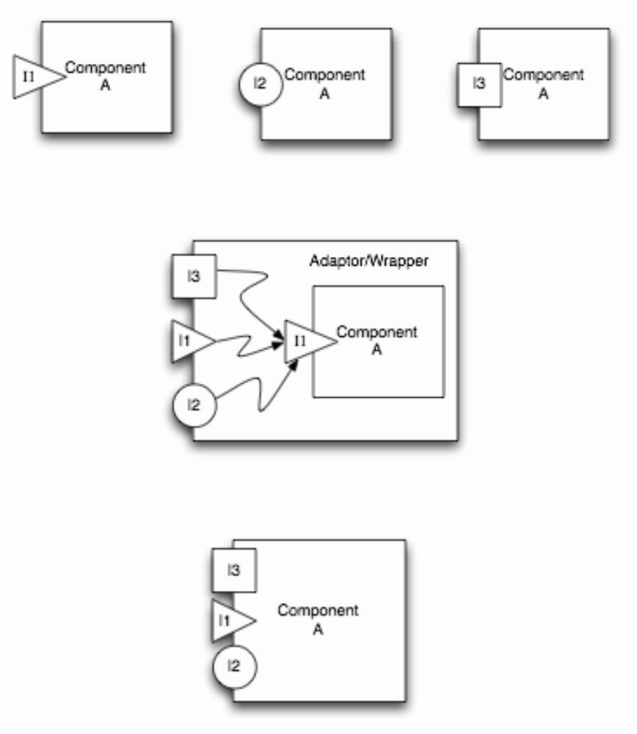
Multiple Interfaces to the Same Functionality
Software Architecture: Foundations, Theory, and Practice; Richard N. Taylor, Nenad Medvidovic, and Eric M. Dashofy; © 2008 John Wiley & Sons, Inc. Reprinted with permission.

Slide 13
Software Connectors and Efficiency
Carefully select connectors
Use broadcast connectors with caution
Make use of asynchronous interaction whenever possible
Use location/distribution transparency judiciously

Slide 14
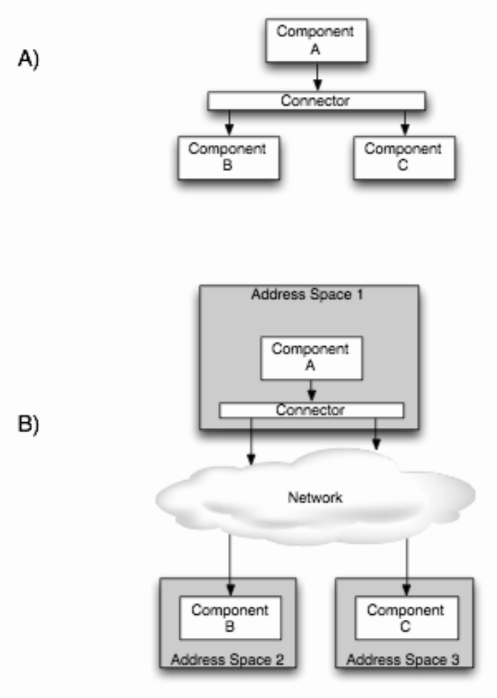
Distribution Transparency
Software Architecture: Foundations, Theory, and Practice; Richard N. Taylor, Nenad Medvidovic, and Eric M. Dashofy; © 2008 John Wiley & Sons, Inc. Reprinted with permission.

Slide 15
Architectural Configurations and Efficiency
Keep frequently interacting components “close”
Carefully select and place connectors in the architecture
Consider the efficiency impact of selected architectural styles and patterns

Slide 16
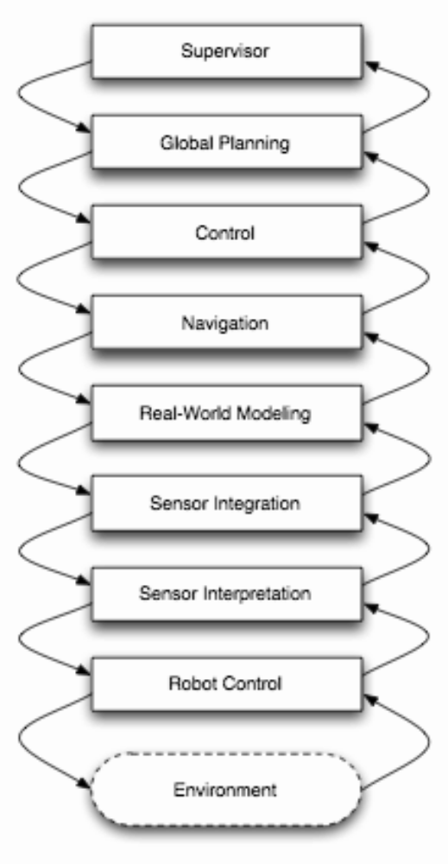
Performance Penalty Induced by Distance
Software Architecture: Foundations, Theory, and Practice; Richard N. Taylor, Nenad Medvidovic, and Eric M. Dashofy; © 2008 John Wiley & Sons, Inc. Reprinted with permission.

